Slide 1
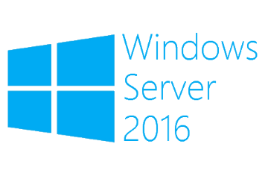
Install first Windows Server 2016 Domain Controller
Megaseries

Slide 2
Steps
Install a new Windows Server 2016 machine
Set basic settings like name, IP and firewall rules
Promote server to domain controller
Create a DNS reverse zone
Create a GPO with basic settings

Slide 3

https://www.youtube.com/channel/UCcZ-jLbPwNr8E_v9-65n8Iw https://github.com/itknowledge4

